Slide 1

McGraw-Hill Technology Education
Copyright © 2006 by The McGraw-Hill Companies, Inc. All rights reserved.

Slide 2
Chapter 5B
Modern CPUs

Slide 3
A Look Inside The Processor
Architecture
  Determines
    Location of CPU parts
    Bit size
    Number of registers
    Pipelines
  Main difference between CPUs
Notes:
Teaching tip
Bit size tends to confuse students. A simple example clarifies the importance of bit size. Consider two equal computers, one has a 32-bit processor, the other a 64 bit processor. With all other items equal, the 64-bit processor will handle twice the data the 32 bit processor handles. This is like driving a car at 55 Mph then doubling it to 110 Mph.

Slide 4
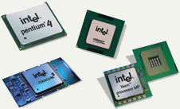
Microcomputer Processors
Intel
  Leading manufacturer of processors
  Intel 4004 was worlds first microprocessor
  IBM PC powered by Intel 8086
  Current processors
    Centrino
    Itanium
    Pentium IV
    Xeon
Notes:
Teaching Tip
Table 5B.1 on page 208 lists several of Intel’s modern processors. A new addition is the Centrino Mobile processor family, designed for laptops with wireless connections.

Slide 5

Microcomputer Processors
Advanced Micro Devices (AMD)
  Main competitor to Intel
  Originally produced budget products
  Current products outperform Intel
  Current processors
    Sempron
    Athlon FX 64
    Athlon XP
Notes:
Teaching Tip
Table 5B.2 on page 209 lists most of the modern AMD processors. A new addition is the Sempron processor, aimed at beating the Intel Celeron and Centrino Mobile processors.

Slide 6
Microcomputer Processors
Freescale
  A subsidiary of Motorola
  Co-developed the Apple G4 PowerPC
  Currently focuses on the Linux market

Slide 7
Microcomputer Processors
IBM
  Historically manufactured mainframes
  Partnered with Apple to develop G5
    First consumer 64 bit chip

Slide 8
Comparing Processors
Speed of processor
Size of cache
Number of registers
Bit size
Speed of Front side bus
Notes:
Teaching Tip
Table 5B.3 on page 210 lists the specifications for three powerful processors.

Slide 9
Advanced Processor Topics
RISC processors
  Reduced Instruction Set Computing
  Smaller instruction sets
  May process data faster
  PowerPC and G5

Slide 10
Advanced Processor Topics
Parallel Processing
  Multiple processors in a system
  Symmetric Multiple Processing
    Number of processors is a power of 2
  Massively Parallel Processing
    Thousands of processors
    Mainframes and super computers
Notes:
Discussion point
Parallel processing is not always as fast as it claims. Make some analogies to multiple workers painting a room. Let the students contribute stories. End the discussion with comments regarding Fred Brook’s statement “No matter how many women are assigned to the task, it still takes nine months to have a baby”.

Slide 11
Extending The Processors Power
Standard computer ports
  Keyboard and mouse ports
  USB ports
  Parallel
  Network
  Modem
  Audio
  Serial
  Video
Notes:
Teaching Tip
Contrast the network and modem port. Point out that the modem port is smaller than the network port. Modems use a 4-wire cable while network ports use an 8-wire cable.

Slide 12
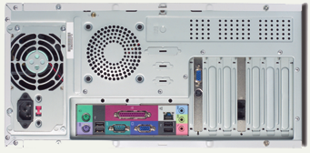
Standard Computer Ports

Slide 13
Extending The Processors Power
Serial and parallel ports
  Connect to printers or modems
  Parallel ports move bits simultaneously
    Made of 8 – 32 wires
    Internal busses are parallel
  Serial ports move one bit
    Lower data flow than parallel
    Requires control wires
    UART converts from serial to parallel
Notes:
Teaching tip
Figure 5B.9 on page 213 shows data flowing through a serial interface. Similarly, Figure 5B.10 on page 214 shows data flowing through a parallel interface.

Slide 14
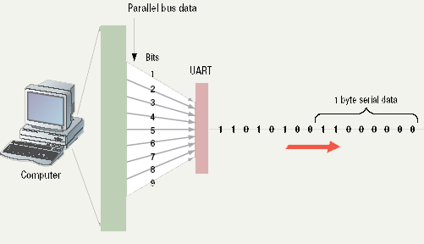
Serial Communications

Slide 15
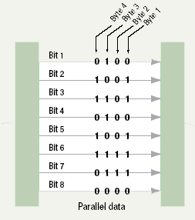
Parallel Communications

Slide 16
Extending The Processors Power
SCSI
  Small Computer System Interface
  Supports dozens of devices
  External devices daisy chain
  Fast hard drives and CD-ROMs
Notes:
Insider information
SCSI is typically found on network servers and high-end workstations. SCSI is unique among the buses discussed so far because it does not use CPU power to control the devices.

Slide 17
Extending The Processors Power
USB
  Universal Serial Bus
  Most popular external bus
  Supports up to 127 devices
  Hot swappable

Slide 18
Extending the Processors Power
FireWire
  IEEE 1384
  Cameras and video equipment
  Hot swappable
  Port is very expensive

Slide 19
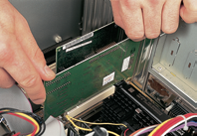
Extending the Processors Power
Expansion slots and boards
  Allows users to configure the machine
  Slots allow the addition of new devices
  Devices are stored on cards
  Computer must be off before inserting
Notes:
Teaching tip
It is helpful to have several cards on hand for demonstration. If possible, use a student to show the technique for inserting a card.

Slide 20
Extending the Processors Power
PC Cards
  Expansion bus for laptops
  PCMCIA
  Hot swappable
  Small card size
  Three types, I, II and III
  Type II is most common

Slide 21
Extending the Processors Power
Plug and play
  New hardware detected automatically
  Prompts to install drivers
  Non-technical users can install devices
Notes:
Insider Information
Plug and play was introduced by Apple Computers.

Slide 22
Chapter 5B
End of Chapter

